Slide 1
Computer Security
COMP6824001
Security Layers
Session 2

Slide 2
These slides have been adapted from:
Panek, Crystal. (2019). Security Fundamental, John Wiley & Sons, Inc. Indianapolis. ISBN: 978-1-119-65066-9
Lesson 1
Acknowledgement

Slide 3
Learning Objectives
LO 1: To explain the security principles, threats, attacks and security strategy
LO 2: To evaluate different strategies to handle security threats and attacks
LO 3: To apply different techniques in handling computer and network security

Slide 4
Social Engineering

Slide 5
Social Engineering
Social engineering is a method used to gain access to data, systems, or networks, primarily through misrepresentation
This technique typically relies on the trusting nature of the person being attacked.
attacker will typically try to appear as harmless or respectful as possible

Slide 6
Social Engineering (Case Example)
Social Engineering attacks can be perpetrated in person, through email, or via phone.
Attackers will try techniques including pretending to be from a Help Desk or Support Department, claiming to be a new employee, or in some cases even offering credentials that identify them as an employee of the company
The key to thwarting a social engineering attack is through employee awareness. If employees know what to look out for, an attacker will find little success.

Slide 7
Avoiding Social Engineering
Be Suspicious : Phone calls, emails, or visitors who ask questions about the company, its employees, or other internal information, should be treated with extreme suspicion
Verify Identity : When receiving inquiries that you are unsure of, verify the identity of the requestor
Be cauitious : Do not provide sensitive information unless certain not only of the person’s identity but also of the person’s right to have the information
Don’t use email : Never respond to email requests for sensitive information and be especially cautious of providing this information after following web links embedded in an email

Slide 8
Linking Cost with Security

Slide 9
Linking Cost with Security
There are some points to keep in mind when developing a security plan :
security costs money : Typically, the more money is spent, the more secure the information or resources will be (up to a point)
strive to make the security seamless : If the security becomes a heavy burden, users will often look for methods to circumvent the security that has been established

Slide 10
Physical Security as the First Line of Defense

Slide 11
Understanding Physical Security as the First Line of Defense
Factors that need to be considered when designing and reviewing physical security to protect assets, system and information :
computer security
securing removable devices and drives
access control
mobile device security
identifying and removing keyloggers

Slide 12
Site Security & Access Control

Slide 13
Understanding Site Security & Access Control
Site security deals with securing the physical premises. The fundamental concept is defense in depth
Defense in depth is a concept in which multiple layers of security are used to defend assets.
Access control is a key concept when thinking about physical security
In the context of physical security, access control can be defined as the process of restricting access to a resource to only permitted users, applications, or computer systems

Slide 14
Physical Security Objective
several goals to keep in mind when designing a physical security plan :
Authentication : Site security addresses the need to identify and authenticate people permitted access to an area
Access Control : determines the area that can be accessed by the user when the identity has been proven and authenticated
Auditing : Provides ability to audit activities within the facility such as reviewing camera footage, badge reader logs or other mechanisms

Slide 15
Understanding Site Security & Access Control (Case Example)
A simple example of defense in depth in the “real world” is a hotel room with a locked suitcase. To get into a locked hotel room, a person needs to get the key lock to work. Once they are past the key, there is a deadbolt that must be bypassed. And once they are past the deadbolt, there is still the lock on the suitcase that must be breached

Slide 16
External & Internal Perimeter

Slide 17
Physical Premises Logical Area
Three physical premises logical area are :
External perimeter : the outermost portion of the location, This typically includes the driveways, parking lots, and any green space the location may support
Internal perimeter : consists of any buildings on the premises, If the location supports multiple tenants, the internal perimeter is restricted to only the buildings that an employee can occupy
Secure areas : locations within the building that have additional access restrictions and/or security measures in place such as data centers, network rooms or research and development private room

Slide 18
Understanding the External Perimeter
external security perimeter is the first line of defense surrounding an office
Common security measures used for external perimeter security include the following :
Security camera
Gate with access badge reader
Perimeter fence
Gate with guard
Guard patrols

Slide 19
Understanding the Internal Perimeter
The internal security perimeter starts with the building walls and exterior doors and includes any internal security measures with the exception of any secure areas within the building
Security features that can be used to secure the internal perimeter :
Locks
Keypads
Security camera
Badge readers (on doors and elevators)
Guard desk

Slide 20
Defining Secure Areas
Location of secure areas :
R&D Department
A lab
Telephone closet
Network room
Other area that requires security control
Secure area security technologies :
Badge readers
Keypads
Biometric technology
Metal detectors
Cameras
Security doors

Slide 21
Computer Security

Slide 22
Understanding Computer Security
Computer security consists of the processes, procedures, policies, and technologies used to protect computer systems
computer security context refer to physically securing computers

Slide 23
Securing Computers
Securing Server
Computer Security Cable : A cable that is attached to the computer and to a piece of furniture or wall
Computer Security Cabinet/Rack : A storage container that is secured with a locking door
Securing Desktop
Desktop computers are typically secured by the same types of computer security cables that can be used with server computers
Desktop computers are frequently used in secure office environments
Securing Mobile Computers
Mobile computers, due to their highly portable nature, have a number of technologies and best practices that can be leveraged to ensure they are not damaged or stolen

Slide 24
Three Types of Computers
Servers : These are computers used to run centralized applications and deliver the applications across a network
Desktop Computers : These computers are usually found in office environments, schools, and homes
Mobile Computers : This category includes laptop, notebook, tablet, netbook computers, and smartphones

Slide 25
Threat Modeling

Slide 26
Performing Threat Modeling
Threat modeling is a procedure for optimizing network security by identifying vulnerabilities, identifying their risks, and defining countermeasures to prevent the effects of the threats to the system
Threat modeling is an iterative process
it should be started when designing a system or solution and should be performed throughout the system or solution lifecycle

Slide 27
Steps to Performing Threat Modeling
Identify assets value
Create an architecture overview
Decompose the security components and applications
Identify the threats
Document the threats
Rate the threats

Slide 28
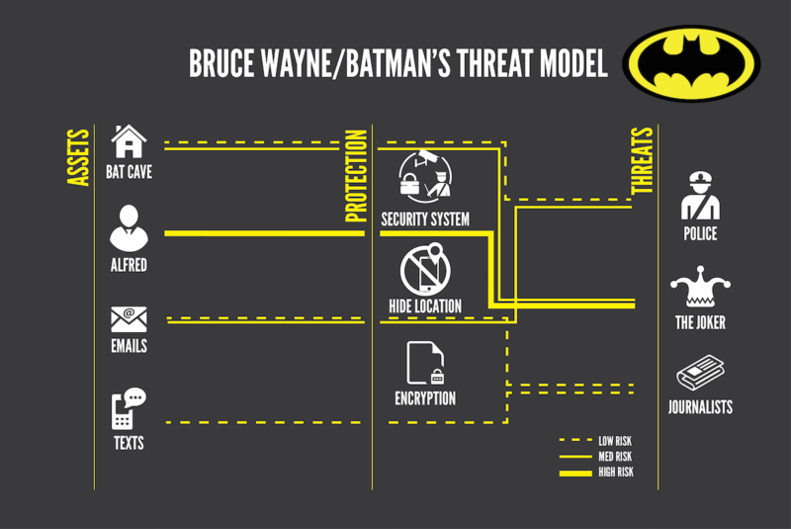
Threat Modeling Example (Batman’s Threat Model)

Slide 29
Security Standards

Slide 30
Security Standards
ISO (International Organization for Standarization)
ISO has published over 22336 International Standards and its related documents which covers almost every industry, from information technology, to food safety, to agriculture and healthcare
There are several series of ISO standards such as ISO 27000, ISO 27001, ISO 27002, 27005, and ISO 27032
IT Act (Information Technology Act)
The IT Act is based on the United Nations Model Law on E-Commerce 1996 recommended by the General Assembly of United Nations

Slide 31
Security Standards
Copyright Act
The Copyright Act 1957 amended by the Copyright Amendment Act 2012 governs the subject of copyright law in India. Copyright is a legal term which describes the ownership of control of the rights to the authors such as books, video, movies, music, and computer program
Patent Law
Traditional patent law protect tangible scientific inventions, such as circuit boards, heating coils, car engines, or zippers. In the modern world patent law can be used to protect business practices, programming algorithms and modified organisms

Slide 32
Security Standards
IPR (Intellectual property rights)
IPR is a right that allow creators, or owners of patents, trademarks or copyrighted works to benefit from their own plans, ideas, or other intangible assets or investment in a creation
IPR provides for the right to benefit from the protection of moral and material interests resulting from authorship of scientific, literary or artistic productions

Slide 33
References
Text Book : Crystal Panek - Security Fundamentals-SYBEX_John Wiley & Sons (2020)
https://cdn.arstechnica.net/wp-content/uploads/2017/06/batman-threat-model-1200-800x535.png

